Slide 1

A192 STIX3923 PROJECT 2 GROUP D FIELD TESTING
Prepared by :
Norhalimah binti Mohamad Ramli
255227

Slide 2
PHP CRUD Generator will easy the end user to build their system step by step and implement four major functions which are create, retrieve, update and delete. It will also expose CRUD as education purpose for them and how web development works. PHP CRUD Generator also will help the developer to build rapid prototype for their customer. It will reduce development-time by simplifying CRUD operations.
OVERVIEW OF THE SYSTEM: PHP CRUD Generator

Slide 3
EVALUATION METHOD of PHP CRUD Generator
Type of Evaluation
Objectives of Evaluation
Participants
To test how well users can learn and use a product to achieve their goals.
To improve the design and interface of the system.
Usability Evaluation
30 participants
Materials
Procedure
PHP CRUD Generator
Questionnaire
First Method
Second Method

Slide 4
RESULTS AND FINDING : PHP CRUD Generator
SECTION A : Demography and Background Information
Gender
Age Group

Slide 5
RESULTS AND FINDING : PHP CRUD Generator
SECTION A : Demography and Background Information
Have you heard about CRUD functions (create, retrieve, update and delete)?
Have you ever use any system with CRUD functions?

Slide 6
RESULTS AND FINDING : PHP CRUD Generator
SECTION B : PHP CRUD Generator
Overall, I am satisfied with the ease of completing this task
Overall, I am satisfied with the amount of time it took to complete this task

Slide 7
RESULTS AND FINDING : PHP CRUD Generator
SECTION B : PHP CRUD Generator
Usefulness of PHP CRUD Generator
PHP CRUD Generator enhances my effectiveness on accessing the system
PHP CRUD Generator increases my productivity

Slide 8
RESULTS AND FINDING : PHP CRUD Generator
SECTION B : PHP CRUD Generator
Ease of Use of PHP CRUD Generator
PHP CRUD Generator is easy to use
PHP CRUD Generator is user friendly

Slide 9
RESULTS AND FINDING : PHP CRUD Generator
SECTION B : PHP CRUD Generator
Navigation and Hyperlinks of PHP CRUD Generator
The homepage clearly directs me towards the information I need
PHP CRUD Generator provides useful cues and links for me to get the desired information.

Slide 10
RESULTS AND FINDING : PHP CRUD Generator
SECTION B : PHP CRUD Generator
Satisfaction of PHP CRUD Generator
I am satisfied with PHP CRUD Generator
I would recommend PHP CRUD Generator to my friend

Slide 11
Based on the results, the respondents can help to improve more the PHP CRUD Generator in the aspects of useful, ease of use, navigation and hyperlinks of it before implementing it in the future. Moreover, most of the respondents satisfied and pleasant to use the PHP CRUD Generator.
IMPLICATION OF THE RESULTS

Slide 12
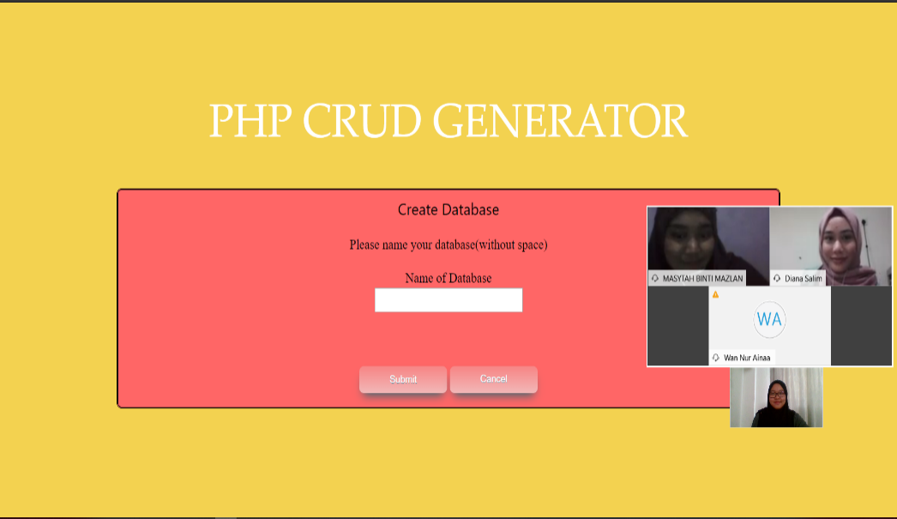
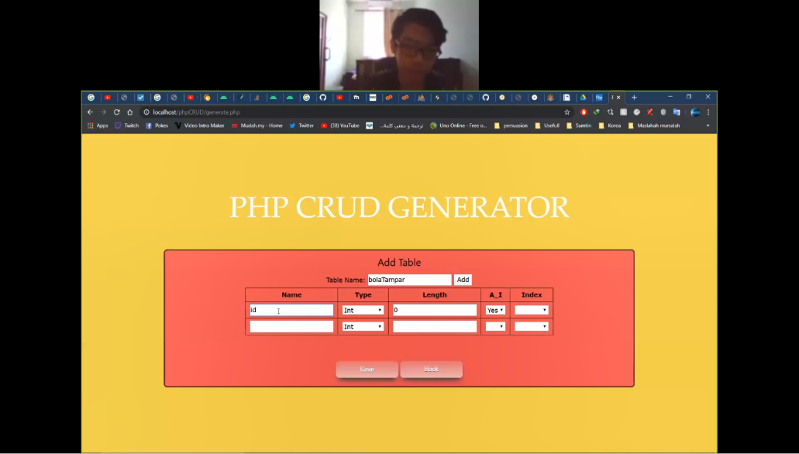
THANK YOU

